Slide 1
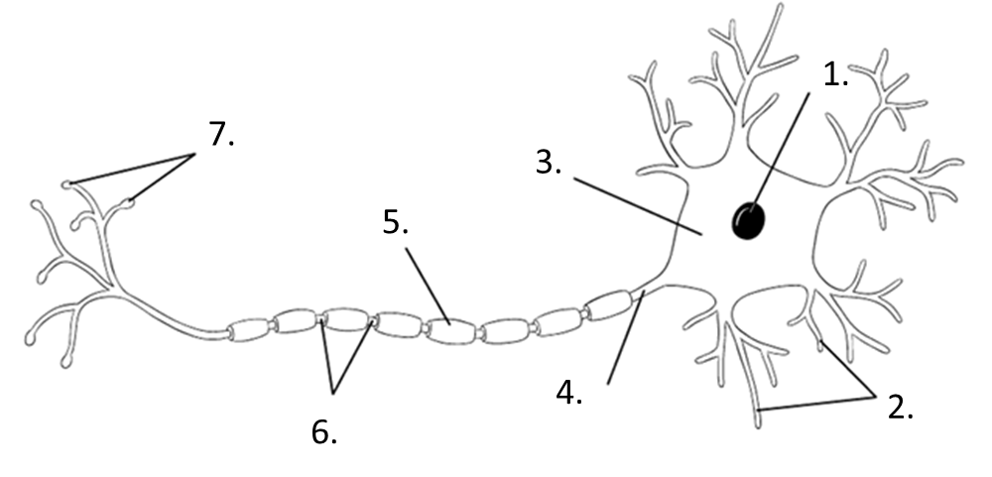
Neurons
3A - Neurons
You burn your finger. Explain how the message of pain is communicated to your brain. (use and underline as many vocabulary words as you can) – You may need to read in 3B about the Nervous System first.
Types of Neurons:
1.
2.
3.
Now explain how your brain sends a message to your muscles to pull your hand back. (use and underline as many vocabulary words as you can) – You may need to read in 3 B about the Nervous System first.
Action Potential:

Slide 2
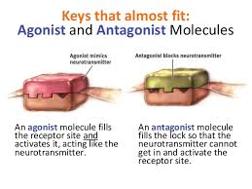
Unit 3A Neural Processing and Endocrine System
Give an example of the following and describe the reaction.
Agonist neurotransmitter:
Antagonist neurotransmitter:
Neurotransmitter | Function | Examples of the malfunctions
Acetylcholine (Ach)
Dopamine
Serotonin
Norepinephrine
GABA (gamma-aminobutyric acid)
Glutamate

Slide 3
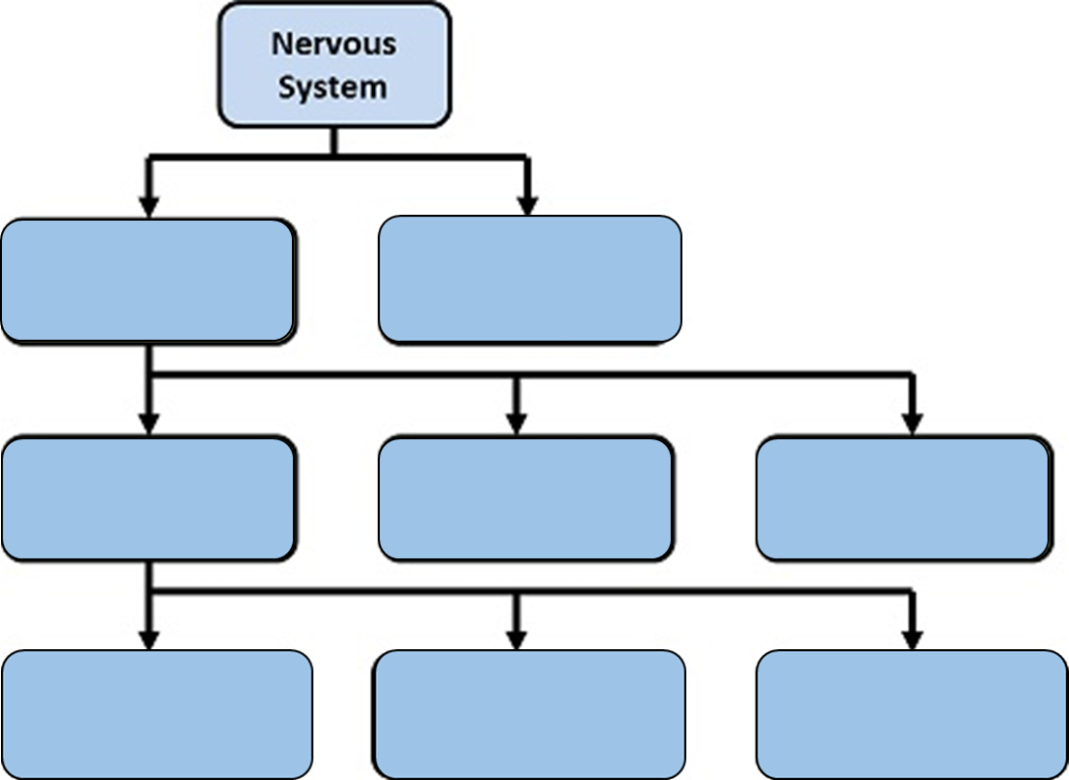
Peripheral Nervous System:
Autonomic
Sympathetic
Parasympathetic
Somatic
Central Nervous System:
Brain
Spinal Cord

Slide 4
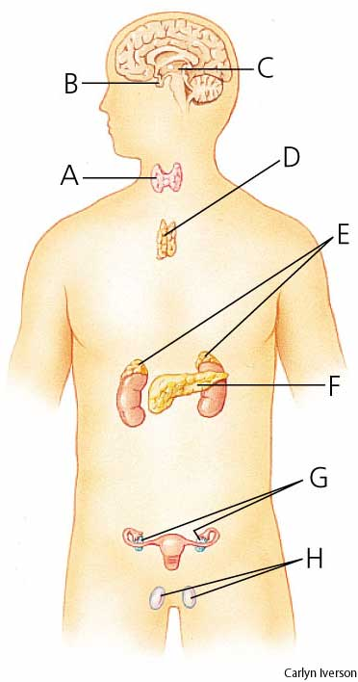
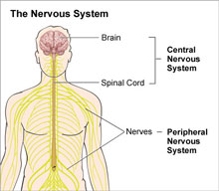
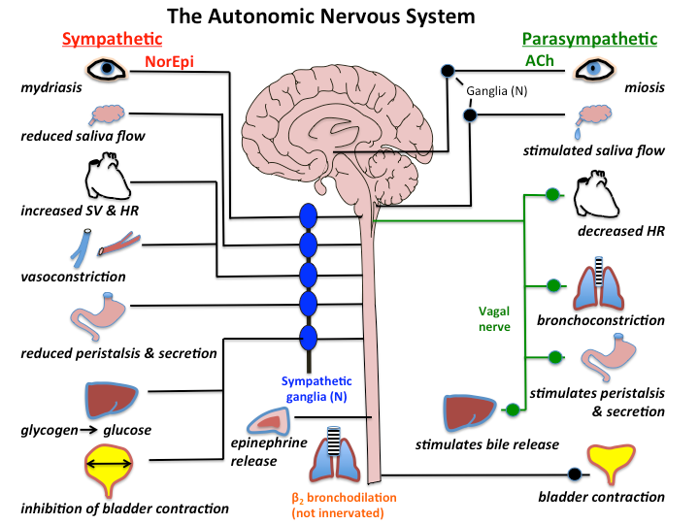
Explain the function of each of the following after filling in diagram to the left:
Thyroid Gland:
Testis:
Pancreas:
Hypothalamus:
Thymus gland:
Pituitary gland:
Ovary:
Adrenal Glands:

Slide 5
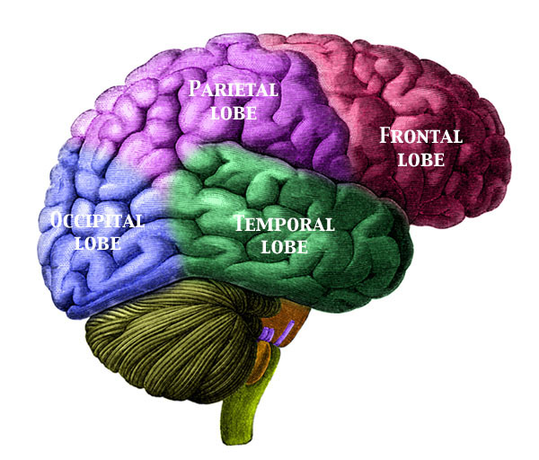
Unit 3B Biological Bases of Behavior
Brain Structures
Hindbrain:
Medulla Oblongata
Cerebellum
Midbrain:
Forebrain:
Thalamus
The Limbic System
Hypothalamus
Hippocampus
Amygdala
Brain Structures Continued.
Cerebral Cortex:
Frontal Lobe
Temporal Lobe
Parietal Lobe
Occipital Lobe
True
True/False? 1. 2. 3. 4. 5. 6. 7. 8. 9. 10.
Phineas Gage:
EEG:
CAT:
MRI:
PET:
fMRI:

Slide 6
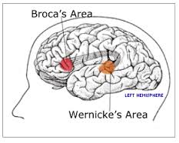
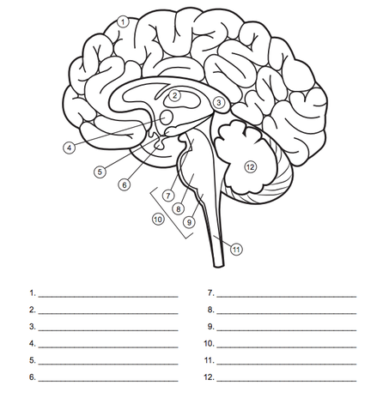
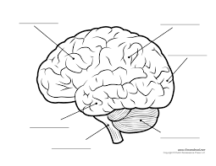
Label the areas of the brain:
Broca’s Area:
Wernicke’s Area:
Label the areas of the brain:

Slide 7
3C Genetics, Nature vs Nurture
Explain the Social Learning Theory in your words:
Nature:
Nurture:
Make an argument supporting Nature for influencing behavior:
Make an argument supporting Nurture for influencing behavior:
Chromosomes:
Genes:
Explain the Evolutionary argument:
Types of Environmental Influences:
1.
2.
3.
4.
5.
6.

